Slide 1
Butterfly Maze
GRADE 1(ages 6+)

Slide 2

Instructions
In this game, players must complete the maze without touching the walls …..with the cursor.
At the end of the maze the players need to “click” on the correct word that is needed to complete the sentence given.
Players will earn 3 points for each correct match they make.
Once a sentence is matched, the player will advance to the next level, each level becoming more challenging.
Once the game is finished, players will receive a score based on the number of correct matches they made.
IMPORTANT: Before starting the game
make sure your “arrow options” are set to “visible”.

Slide 3

Level 1
Place the cursor on
the sun to begin

Slide 4
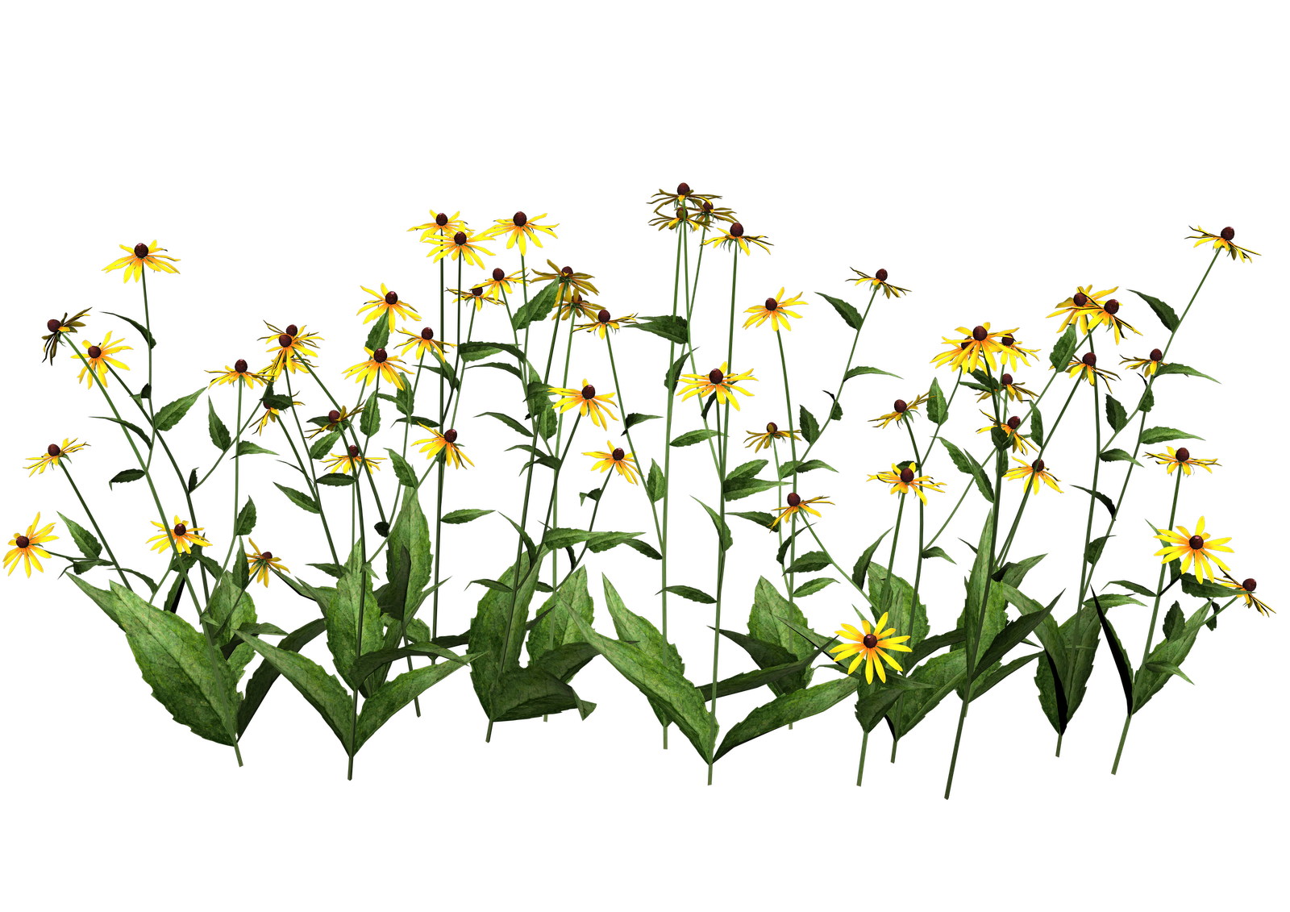
Level 1
Complete the sentence:
Butterfly’s wings have many vibrant ____.
Colors
Flavors
This Photo by Unknown Author is licensed under CC BY-NC
This Photo by Unknown Author is licensed under CC BY-NC

Slide 5
Super!
You’ve earned 3 Points!

Slide 6
Level 2
Place the cursor on
the sun to begin

Slide 7

Level 2
Complete the sentence:
Butterflies come from _______.
Dirt
Caterpillars

Slide 8
Amazing!
You’ve earned 3 MORE Points!

Slide 9
Level 3
Place the cursor on
the sun to begin

Slide 10
Level 3
Complete the sentence:
Butterfly wings are _______.
Delicate
Sturdy

Slide 11

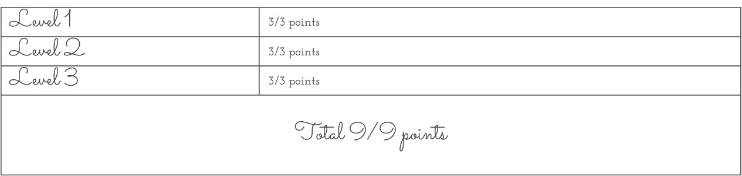
You’ve completed the game!
You earned all 9 Points!

Slide 12
GAME OVER
Restart Game
End Game

Slide 13
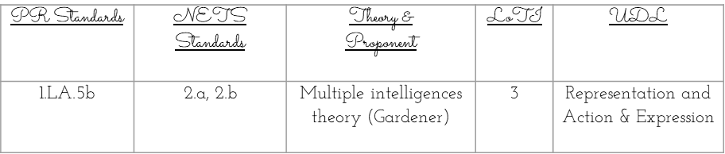
Name: Stephanie Rodriguez Acevedo
Grade: 1rst Grade
Skills being practiced:
  The game primarily practices critical thinking and problem-solving skills.
  Players are required to navigate a maze, which involves planning and decision-making.
  The game requires players to develop reading comprehension and vocabulary.
  Finally, the game rewards players for their accuracy, which encourages attention to detail and quick decision-making.
  Overall, this game provides a fun way for students to practice a range of cognitive skills.
.

Slide 14
:
  References:
  PR Standards curriculum:
  Curricular English Map: Unit 1.1/DE (2023)
  http://intraedu.dde.pr/Materiales%20Curriculares/Forms/AllItems.aspx?RootFolder=%2FMateriales%20Curriculares%2FEnglish
  Nets standards students & Teachers:
  ISTE. Standards for students(2023). https://www.iste.org/standards/iste-standards-for-students
  ISTE. Standards for teachers (2023). https://www.iste.org/standards/iste-standards-for-teachers
  Theory:
  Marenus, M. (2023). Howard Gardner's Theory of Multiple Intelligences. Simply Psychology. https://www.simplypsychology.org/multiple-intelligences.html
  LOTI:
  LoTi Framework. (n.d.). Loticonnection. https://www.loticonnection.com/loti-framework
  UDL:
  National Center on Universal Design for Learning. (2015, March 31). Let’s Take a Tour of UDL [Video]. YouTube. https://www.youtube.com/watch?v=JR8EPXsTgbA

Slide 16
Try again!
Level 1 Failed
Restart

Slide 17
Try again!
Level 2 Failed
Restart

Slide 18
Try again!
Level 3 Failed
Restart

